Slide 1
Survey Report IPEXPO 2015
Top priorities and Technology Trends

Slide 2
IPEXPO Survey 2015
IPEXPO Europe is one of the largest gatherings in Europe of IT professionals,
Vendors, Distributors and Solution providers. thinkS3 Attended this year’s event
and sought to discover what was really driving the business decisions within IT
and what was taking the priority for the department now.
Notes:
Lifecycle Includes assessment that looks at power usage of current infrastructure and advises on the environmental benefit of a virtualisation project including the amount of carbon saved and what that is equivalent to.
Our solutions double the traditional IT refresh lifecycle and enable the organisation to be more flexible and cost effective, therefore providing competitive advantage

Slide 3
Survey Demographics
Over 150 Respondents Surveyed
All verified results are from Senior IT Professionals in the UK
Companies range from SMB to Global Enterprise
Notes:
We talk with lots of customers, and even though their environments and businesses are very different, many of the same challenges come up over and over again. IT managers consistently struggle with handling explosive data growth, the need to do more with less, keeping up with change while maintaining constant availability, keeping data out of the hands of the wrong people and keeping their bosses out of jail.
Our unified storage allows customers to actually “do more with less”
One of the newer trends we’re seeing is a real focus on application integration, because people want to spend more of their resources focused on increasing the performance of their critical business applications, not worrying about low-level infrastructure components like storage. This is one of the reasons that we work so closely with our global partners, Oracle, Microsoft, Symantec and SAP, so their applications can take direct advantage of our innovation. Over time, that integration will deliver the benefits of our storage innovation directly into the hands of their customers.
Another trend we’re seeing is the recognition of the broad impact a company’s IT infrastructure can have on business. This, in turn, means CIOs everywhere are looking to align their IT capabilities with the company’s business challenges.
These are just some of the things we see broadly across the industry, but I’m curious about the challenges you face. Do they align to this list pretty well? What would you say are the biggest and hardest challenges you face?

Slide 4
How Happy are you?
In the first section of our Survey we asked our CIO’s and IT Directors to
look across their estate and narrow down how they really felt about
solutions and services as they stood currently.
Notes:
Sustainability is about demand management. As demand increases we cannot increase supply but instead be smarter about how we use what we have today. Through our processes and procedures we promote exactly that philosophy.
Initial positioning and benefits statement
Identification of scope
Run through of process
Past references and examples
Typical figures (servers 10:1, storage x:y)
Linking of Business benefits to IT Solution
Recommendations
Business case development
High level project plan
Initial costings
Detailed design of target solution
Detailed project plan of implementation, and migration
Purchase of required Hardware and Software licences
Definition of services to support project , transitional and ongoing management
Commitment to deliver
Execution phase – doing what we said we will do
Implementation of target solution
Migration
Verification of success
Decommission of source hardware
Focus – no distractions from BAU activities
Transitional stage of Lifecycle
Proving solution continues to work
Developing process and procedures to support new environment
Knowledge transfer to existing customer resource
Removal of ‘fear’ from managing new technology
Allows existing staff to focus on day to day role and live services
Clearly defined exit plan – non threatening phase
Governance and management
Regular status updates
Monthly Programme Boards
Benefits realisation

Slide 5
Data Storage
Data Storage is essential to any business and our chart shows that data storage by large is looked after pretty well in business. Whilst only a small section feel perfection has been achieved there is a good level of confidence in the existing systems and this continuous to grow.
With the emergence of Cloud and All Flash the data storage landscape has changed for the better.

Slide 6
Server Consolidation
Server consolidation has been growing well across the enterprise market place as companies reduce their complexity and re-purpose environments. Virtualisation and Cloud technologies continue to drive server consolidation.
This is reflected in the confidence IT Professionals are showing when dealing with consolidation projects.

Slide 7
Backup & DR
Possibly one of the more surprising results in this survey was the high number of Backup and DR solutions that simply did not meet the grade for a business critical system.
With 3-2-1 best practice proving hard to achieve with traditional solutions Cloud is increasingly being deployed to update and achieve best practice.

Slide 8
VDI
For some VDI has now fallen a little to the wayside in favour of Cloud technologies, but that does not stop VDI from still being an a viable approach to enabling a rapidly deployable and easy to manage platform to deliver desktop infrastructure.

Slide 9
Managed Service
Managed Services are common place in a cloud driven age. With many suppliers able to offer a simple purchasing model and relieving IT professionals from some of the more time consuming tasks.

Slide 10
Data Centre Services
Managed Services are common place in a cloud driven age. With many suppliers able to offer a simple purchasing model and relieving IT professionals from some of the more time consuming tasks.

Slide 11
Data Storage

Slide 15
S3 and Atlas Converting Equipment Ltd
First meeting
Understanding project scope and business needs
Rapid response
Building trust and confidence
Focus on maximizing value and stabilising the platform

Slide 16
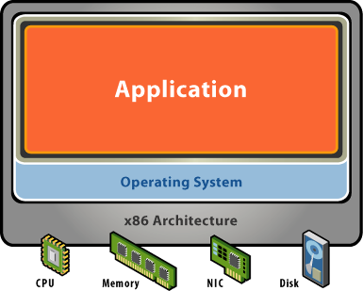
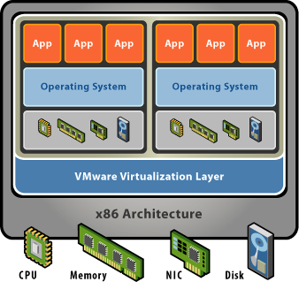
Why Virtualise
Servers reaching end of life
Increased performance
Increased availability and service level capability
Improved manageability
Scalability - sustainable
Reduce costs – opex and capex
Increase business service levels
Increase business continuity capability
Gain operational flexibility
Get more from your resources and your investment
10x productivity
Notes:
60% electricty saving
40% capital costs
Admin time
Networking
Eliminate planned downtime

Slide 17
The Solution
2 servers for production Environment
High Availability for Production
Automated
High performance
Disaster Recovery capability
Portable
Scalability
Backed by S3’s service guarantee
Notes:
Lifecycle Includes assessment that looks at power usage of current infrastructure and advises on the environmental benefit of a virtualisation project including the amount of carbon saved and what that is equivalent to.
Our solutions double the traditional IT refresh lifecycle and enable the organisation to be more flexible and cost effective, therefore providing competitive advantage

Slide 18
Solution enefits
22 servers hosted on 2 physical servers
Local high availability for entire infrastructure
Cost effective protection from site disaster
Scale at minimal cost
Improved application time to deliver
Improved performance
“Sustainable Datacentre Solutions The future of computing is virtual and green”
Notes:
Lifecycle Includes assessment that looks at power usage of current infrastructure and advises on the environmental benefit of a virtualisation project including the amount of carbon saved and what that is equivalent to.
Our solutions double the traditional IT refresh lifecycle and enable the organisation to be more flexible and cost effective, therefore providing competitive advantage

Slide 19
In Summary
Leading edge solution
Lower TCO
Secure and flexible Infrastructure
Effective and efficient technology, manageability and administration
A green & cost effective IT solution
Governance
Virtualisation specialists backed by the Industry Leaders

Slide 20
S3 Consulting
Sustainable Datacentre Solutions
The future of computing is virtual and green

